Slide 1
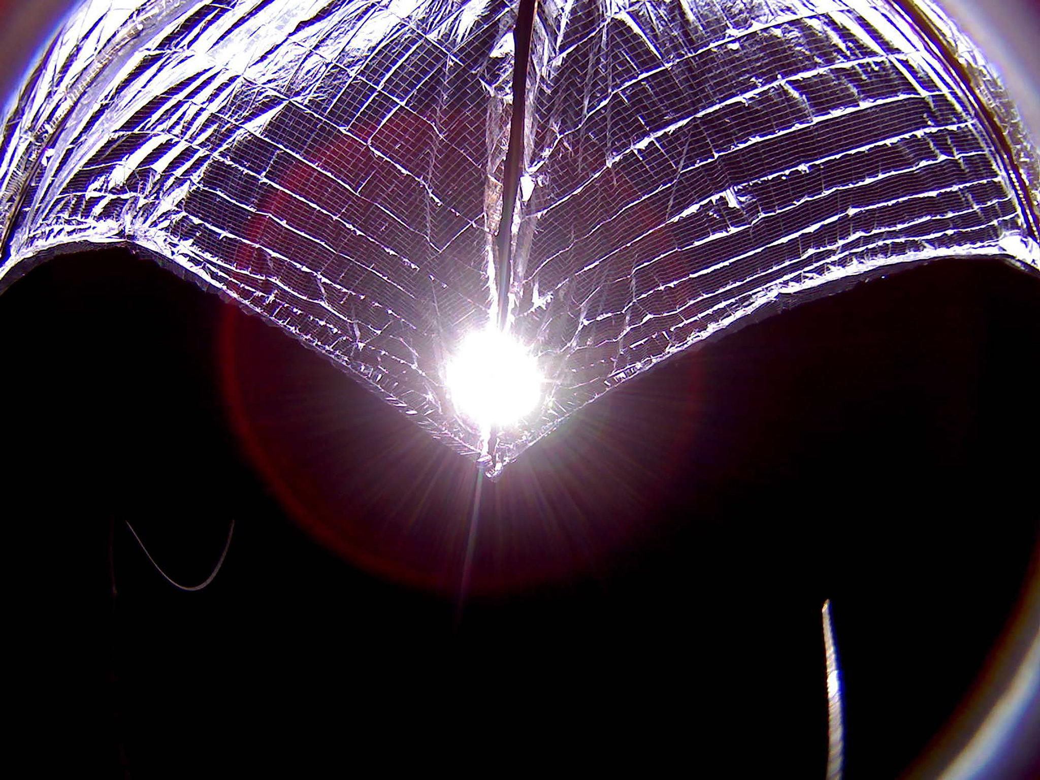
Capstone 007
Geoshade

Slide 2
Client
Tim Sippel, the founder and CEO of Geoshade project.
Client Needs
Design a Solar sail with currently available technology that offsets carbon emissions.

Slide 3
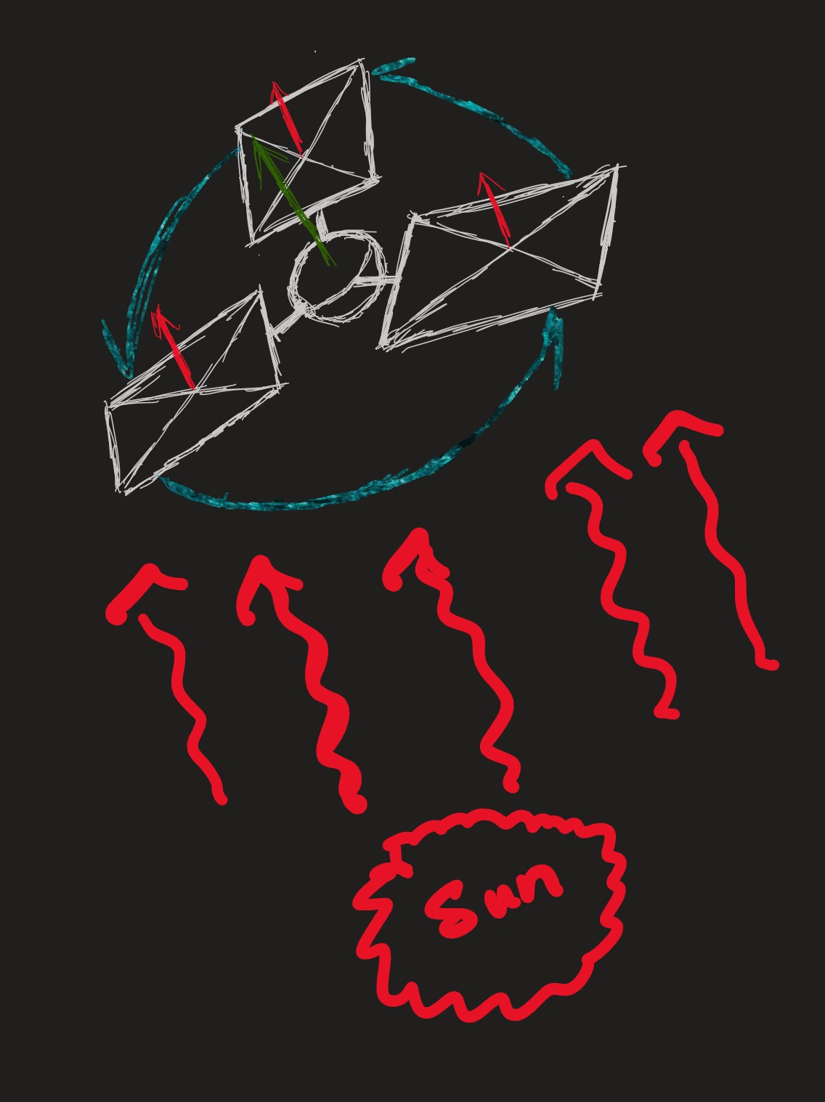
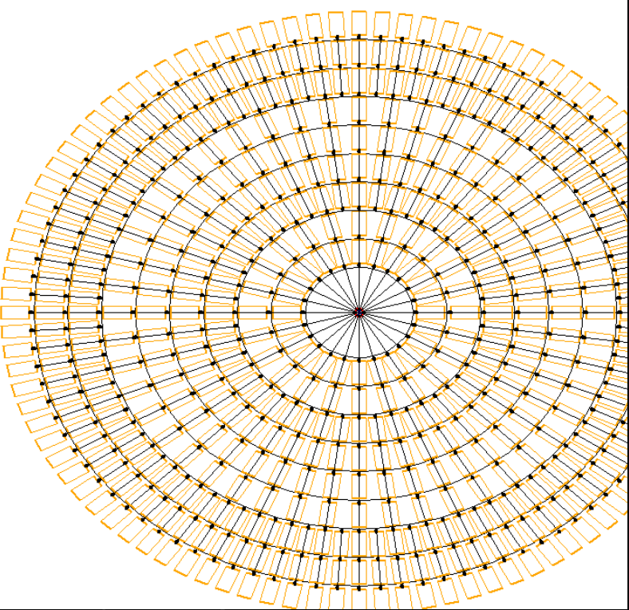
Geoshade

Slide 4
Narrowing the Scope
Preliminary research on the space environment and current solar sail technology
Combine technology from other solar sails to help designing GeoShade
Our scope
Mathematical Model
Actuator Mechanism
Deployment System

Slide 5
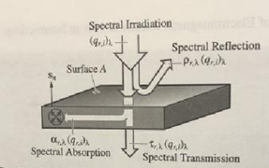
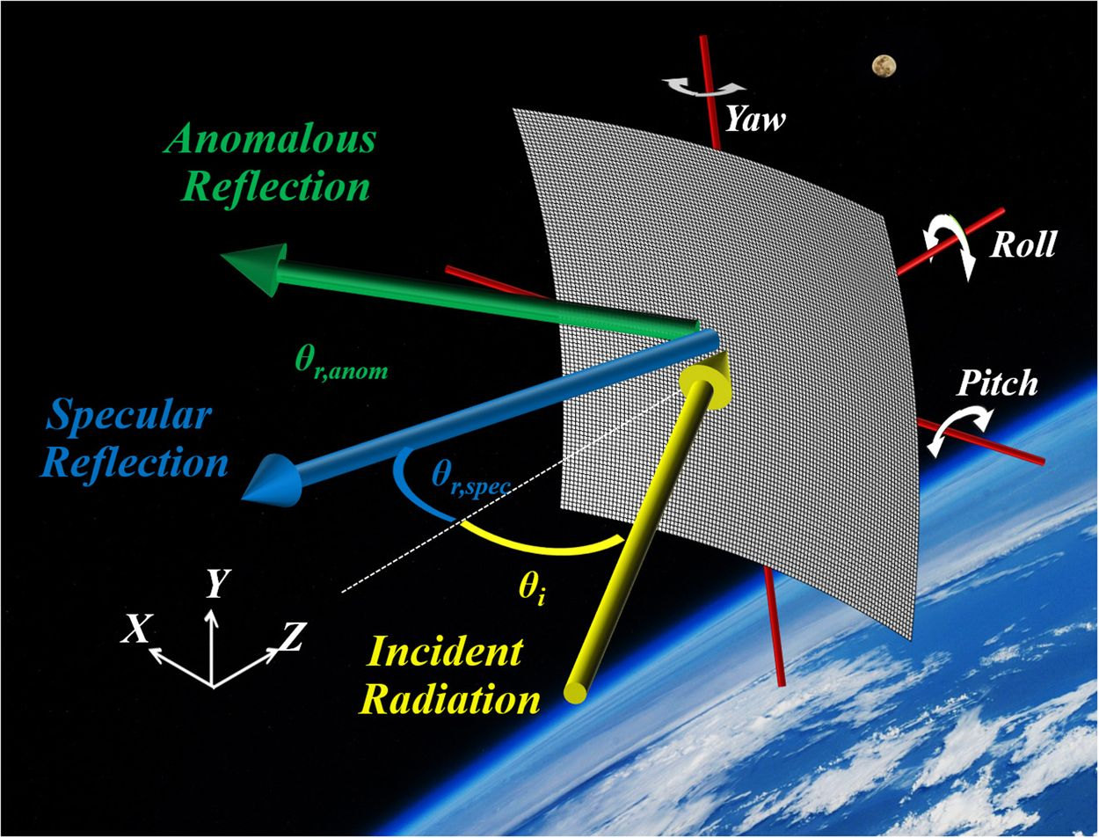
Mathematical Model
Purpose
Assumptions
Sum of forces (F=Fr+Fa+Fe)
Optical Properties
3-D Diagram
Attitude control Model
Issues
Solution
Tensor Calculus

Slide 6
Actuator
Solar sail rotating independently
Sail/Rod Deployment
Attitude Control
Finding an appropriate actuator from desired Torque values, size, and cost
Radiation hardening on currently available electrical components
Privatized and very few companies do it. Drives up High Cost
Alternatives such as Rust/Polymer coating that reduces cost and weight.

Slide 7
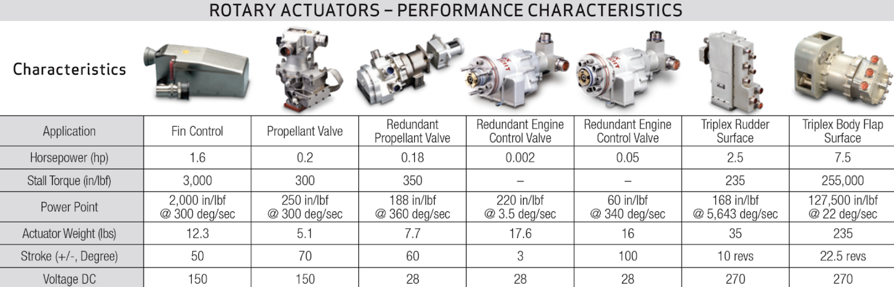
Actuator Selection

Slide 8
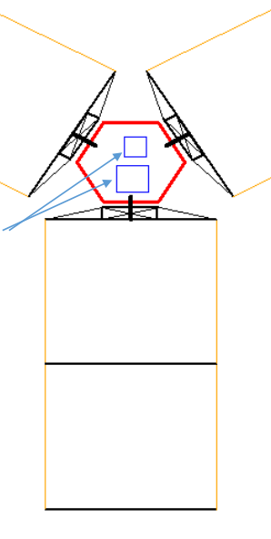
Deployment System
Different folding methods
Different deployment methods
Simulation and modeling
Mock ups

Slide 9
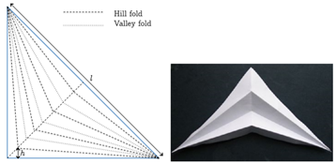
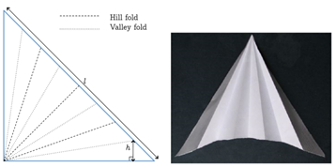
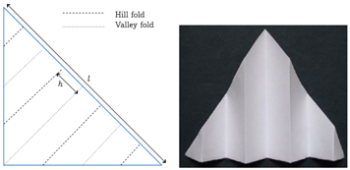
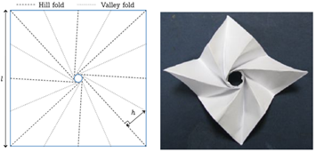
Current Folding Patterns
Notes:
Top left: Tension lines parallel with crease lines, require more force
Top right: Improved but converges at one point → causing high concentration force
Bottom right: Best choice
Bottom left: Too difficult to upscale/ unless for us

Slide 10
Q?

